Slide 1
Cantilever Beam Experiment
Final Project
Josh Bevan
Anthony Schifiliti
Matthew Spinazola

Slide 2
Overview

Slide 3
Objectives
The objectives of this project were to:
  Measure the displacement, natural frequency, and damping ratio of a cantilever beam using 3 transducers located at 3 points on the beam.
  Optimize the output response of the three transducers.
  Investigate the feasibility of measuring dynamic characteristics of other structures (turbine blade) using similar sensors and experimental setup

Slide 4
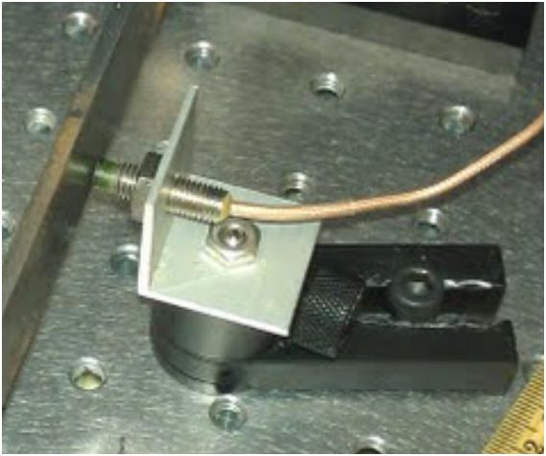
Transducers
Accelerometers:
  Two accelerometers were used to find acceleration at two positions on the beam
Eddy current probe (ECP):
  Used to measure displacement
  Similar to LVDT used in M.E. Lab I
  Small linear range

Slide 5
Theory

Slide 6
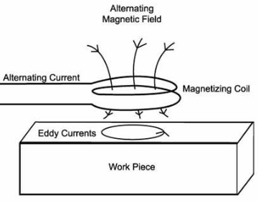
Eddy Current Probe
Measure distance between sensor head and an electrically conducting surface.
Sensitivity based on material of surface.
Magnetic flux lines interact with the conducting surface and are sensed with an impedance bridge [2].
http://www.cnde.iastate.edu/faa-casr/engineers/

Slide 7
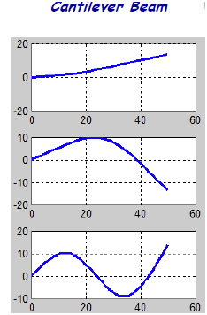
Mode Shapes
A mode describes how the structure responds at a natural frequency
A node of a mode is where there is no displacement over time.
Relevant derivation for cantilever beam given in [3].
Image: Dr. Peter Avitabile, Spectrum Analysis 053110- 9 Copyright © 2001

Slide 8





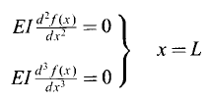

Mode Shapes - Derivation
From elementary beam theory and equilibrium
Using separation of variables, the spatial part:
For a uniform beam a general solution is
where:
For a cantilever beam the BCs are:

Slide 9
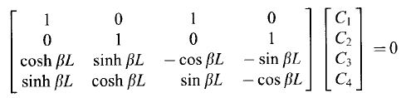


Mode Shapes- Derivation
Substituting f(x) in the BCs yields the:
The C coefficients are nonzero when the determinant of the left matrix is zero, or:
Substituting in the frequency equation yields a solution to the eigenfunction of:

Slide 10


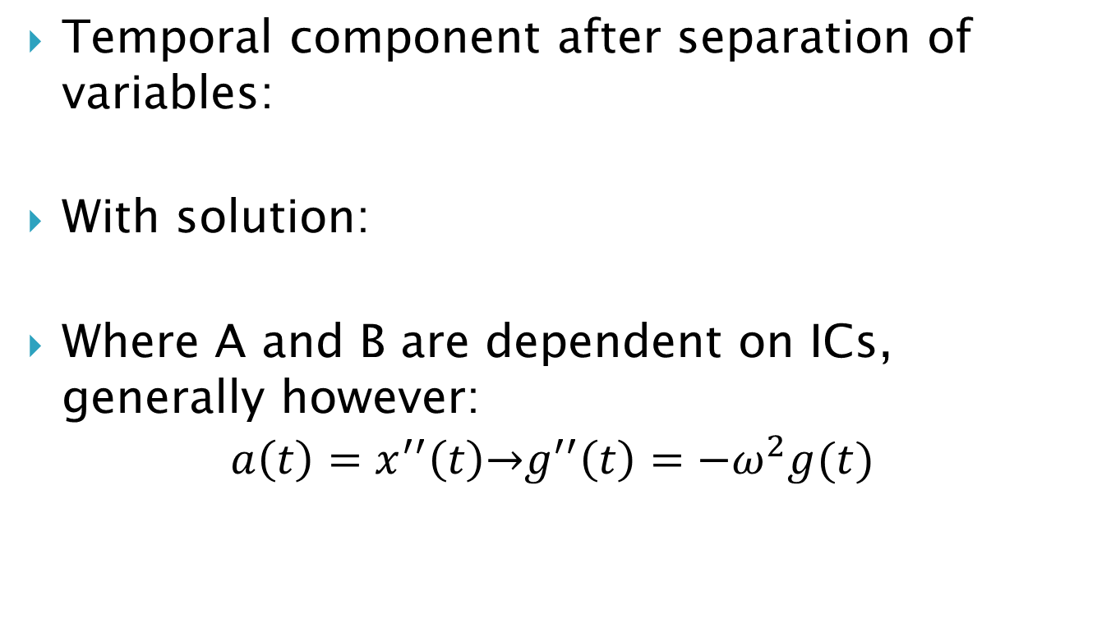
Acceleration from Mode Shape
Temporal component after separation of variables:
With solution:
Where A and B are dependent on ICs, generally however:
$$a\left(t\right)=x^{′′}\left(t\right)\overset{→}{ }g^{′′}\left(t\right)=−ω^{2}g(t)$$

Slide 11


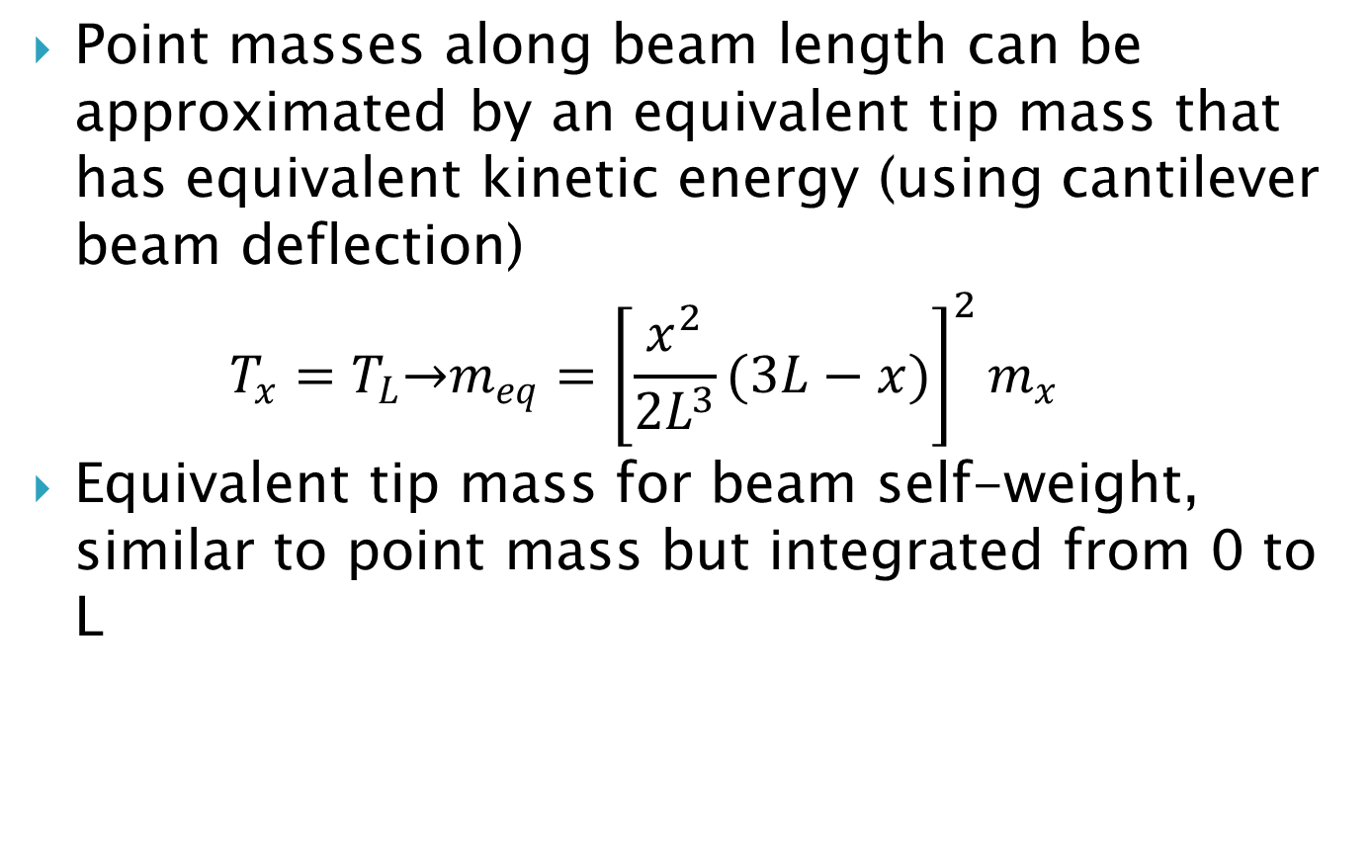
Equivalent Tip Mass
Point masses along beam length can be approximated by an equivalent tip mass that has equivalent kinetic energy (using cantilever beam deflection)
$T_{x}=T_{L}\overset{→}{ }m_{eq}={\left[\frac{x^{2}}{2L^{3}}(3L−x)\right]}^{2}m_{x}$
Equivalent tip mass for beam self-weight, similar to point mass but integrated from 0 to L

Slide 12



Log Decrement (δ)
Used to find the damping ratio.
  n= the number of periods away the specific peak is situated
  x(t)= amplitude of peak
  x(t+nT)= amplitude of a peak n periods away

Slide 13
Drift
Result of numerical integration. Errors compound as integration adds more and more data points.
In simple case constant bias error can be compensated with constant offset.
In more complex cases the bias error is time dependent. The DC component of the signal must be found and adjusted to compensate dynamically for drift.

Slide 14
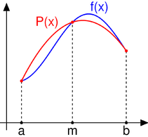



Simpson’s Rule
Method for numerical integration.
This method is more accurate
with an error bound of:
Compared to the error bound of the difference method
http://en.wikipedia.org/wiki/File:Simpsons_method_illustration.png

Slide 15
Design Details

Slide 16
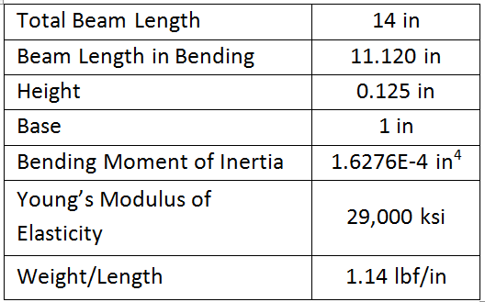
Beam Information
Table 1 Dimensions of cantilever beam based on section number (805D)
Notes:
E of steel not used in calculations

Slide 17
Accelerometer’s Mass
The mass of the tip accelerometer was 4.435g
The mass of the mid beam accelerometer was 7.402g
Mass of the free section of the beam was 178.692g.
Point masses on a cantilever beam changes the natural frequency of the structure

Slide 18
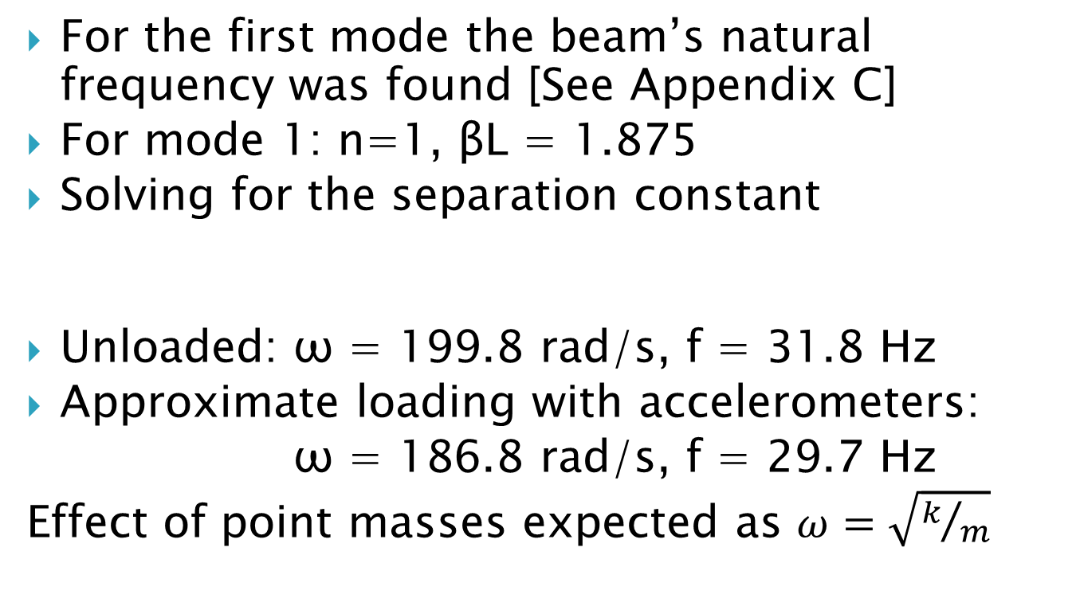
Beam’s Natural frequency
For the first mode the beam’s natural frequency was found [See Appendix C]
For mode 1: n=1, βL = 1.875
Solving for the separation constant
Unloaded: ω = 199.8 rad/s, f = 31.8 Hz
Approximate loading with accelerometers:
ω = 186.8 rad/s, f = 29.7 Hz
Effect of point masses expected as $ω=\sqrt{k/m}$

Slide 19
Displacement Along Beam
Using eigenfunction, beam shape was plotted for full beam length.
Coefficient A_{n} is arbitrary, was calculated to yield desired deflection at x=L

Slide 20
Displacement Along Beam

Slide 21
Acceleration Along Beam
As shown by separation of variables eigenfunction shape is time-invariant, only change is amplitude derived from temporal component.
Acceleration scaled by -ω² term. Investigated for both loaded and unloaded configurations.

Slide 22
Acceleration Along Beam

Slide 23
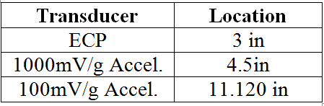
Proposed Design Details
Eddy current probe placed to maximize output without clipping.
Less sensitive accelerometer placed at the beam tip to prevent overloading.
Table 1: The location on the beam of the transducers.

Slide 24
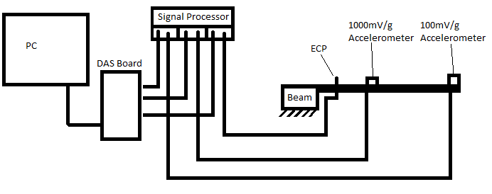
Measurement System Configuration

Slide 25
Results & Analysis

Slide 26
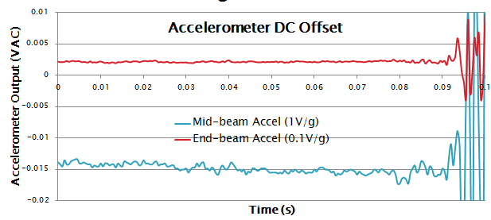
Static Offset Calibration
DC offset present in accelerometer outputs
RMS value taken of signal at rest and subtracted from signal

Slide 27
Dynamic Offset
Non-constant bias error means constant offset inadequate. Dynamic offset calculated using moving average with same period as signal.

Slide 28
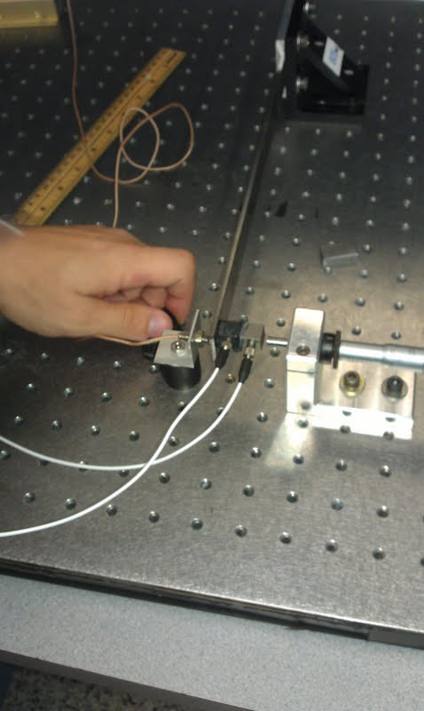
Frequency Variable Response of Sensors
Eddy current probe calibrated statically, 0 Hz
Accelerometers calibrated with shaker,160 Hz
Actual beam response ~30 Hz
Needed to verify sensor behaviors at 30 Hz the same as 0 or 160 Hz
All sensors placed on same location at beam end and displacement calculated
Agreement between displacements indicates similitude

Slide 29
Frequency Variable Response of Sensors

Slide 30
ECP Calibration
Calibrated with the eddy current probe at the tip of the beam. Micrometer at the tip of the beam.
Calibrated at final measurement position. Micrometer still at tip of beam.

Slide 31
ECP Calibration

Slide 32
Unwanted Mode Excitation
Mode 2 excited
Solution: place the mid-beam accelerometer at the node of Mode 2
x= 8.56 in found using mode shape eigenfunction with β=4.694 for n=2
This should remove the Mode 2, allowing Mode 1 to be seen more accurately
Image: Dr. Peter Avitabile, Spectrum Analysis 053110- 9 Copyright © 2001

Slide 33
Unwanted Mode Excitation

Slide 34
Acceleration from Accelerometers

Slide 35
Integration
Accelerometer voltage output converted to acceleration using calibrated sensitivities
Accelerometer data numerically integrated twice with Simpson’s rule to get displacement functions
Constant offset or dynamic offset used to minimize drift

Slide 36
Derived and Measured Displacement

Slide 37
Derived and Measured Displacement
Excellent agreement between displacement measured with ECP, and derived acceleration from accelerometers
Derived displacement from mid-beam accelerometer was scaled according to mode shape to implicitly calculate beam tip displacement
Anomaly of note: prior to scaling the derived initial displacement from the mid-beam accelerometer was already correct value, incorrect after scaling.

Slide 38
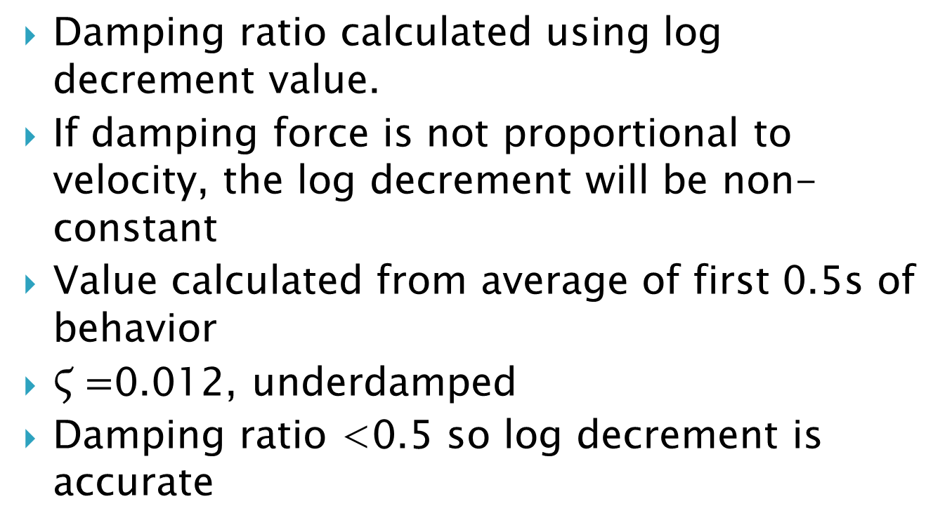
Damping Ratio
Damping ratio calculated using log decrement value.
If damping force is not proportional to velocity, the log decrement will be non-constant
Value calculated from average of first 0.5s of behavior
$Ϛ=$0.012, underdamped
Damping ratio <0.5 so log decrement is accurate

Slide 39
Damping Ratio

Slide 40
Natural Frequency
Natural frequency of system calculated from damped frequency and damping ratio
Measured by counting peaks in 40 signal periods
Experimentally measured value: 26.86 Hz
Calculated theoretical value: 29.70 Hz
Difference: 9.6%
Fair agreement, discrepancy possibly due to imperfectly stiff fixed constraint.
Effects of rotary inertia and shear deformation negligible.

Slide 41


Corrected Natural Frequency
Solving eigenfunction with rotary inertia and shear deformation terms accounted for yields modified equation:
For our beam d/L=90, ω’/ω=0.00215%
Non-negligible for beams with smaller d/L
Shape factor for shear deformation Radius of gyration

Slide 42
Tabulated Results
Transducer | Tip Displacement (m) | Natural Frequency (Hz) | Damping Ratio
Theoretical | 0.002159 | 29.7 | N/A
Calculated
Eddy Current Probe | 0.00213 | 26.86 | 0.012
0.1 V/g Accel | 0.0022 | - | -
1 V/g Accel | 0.0022 | - | -

Slide 43
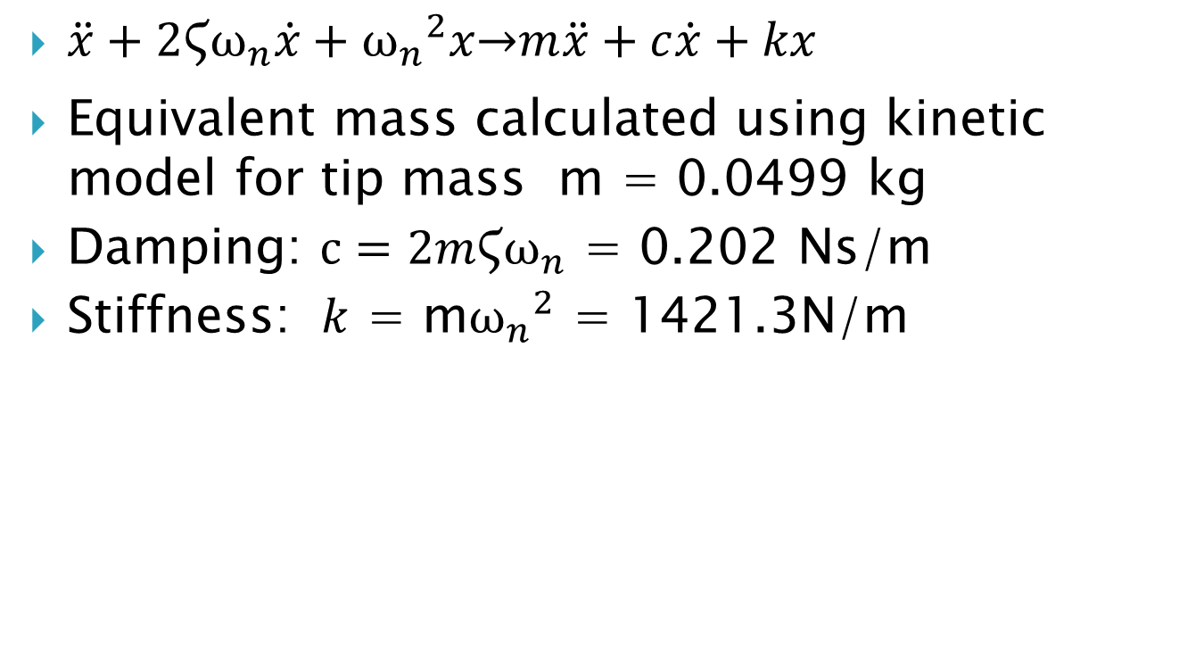
Mass, spring, dashpot model
$\ddot{x}+2Ϛω_{n}\dot{x}+{ω_{n}}^{2}x\overset{→}{ }m\ddot{x}+c\dot{x}+kx$
Equivalent mass calculated using kinetic model for tip mass m = 0.0499 kg
Damping: $c=2mϚω_{n}$ = 0.202 Ns/m
Stiffness: $k$ = m${ω_{n}}^{2}$ = 1421.3N/m

Slide 44
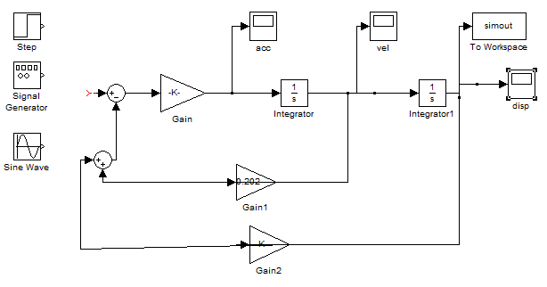
Simulink Model Comparison
Simulink model of 2nd order system built using measured m,c, and k values.
Compared to measured system response
Excellent agreement initially with over-predicted damping from Simulink model because of actual non-constant damping ratio

Slide 45
Simulink Model Comparison

Slide 46
Difficulties Faced
Small linear range for eddy current probe
Mass due to accelerometers
Unwanted higher mode excitation
Drift when integrating acceleration data
Calibration of 3 transducers at frequencies other than system frequency

Slide 47
Conclusions

Slide 48
Mode Shapes for Cantilever Beam
Displacement of beam at a point can be predicted based of the predicted mode shape.
Displacement along the beam and be related to the acceleration along the beam.
Knowing the expected displacement and acceleration along the beam, locations for the transducers can be chosen. Chosen locations maximize the transducers output without overloading. Preventing quantization and clipping errors.

Slide 49
Measuring Beam Tip Displacement with Eddy Current Probe
Eddy current probe’s linear range and sensitivity was found at the beam tip (location of micrometer) and at its final position (3 in from fixed end). Linear range is small; calibration must be done in small increments.
Displacement at ECP’s position can be related to the displacement at the beam tip using the mode shape.

Slide 50
Measuring Beam Tip Displacement with Accelerometers
1 V/g and more sensitive 0.1 V/g accelerometers were available and used.
The more sensitive accelerometer was located closer to the fixed end to accurately record the lower acceleration.
The less sensitive accelerometer was located at the beam’s tip (the location of interest).

Slide 51
Measuring Beam Displacement with Accelerometers
The 0.1 V/g accelerometer showed higher frequencies on top of the frequency of interest (mode 1 ≈31Hz). Placing this accelerometer at the node of mode 2 removed it’s effect.
Simpson’s Rule for integration can be used to find displacement with acceleration data more accurately and helps to reduce drift.
Drift resulting from integration can be corrected by removing the dynamic offset.
Mid beam acceleration → mid beam displacement → tip displacement.

Slide 52
Three Transducers at Three Locations
3 transducers measured similar tip displacements.
Any one of these could be used on their own.

Slide 53
Natural Frequency and Damping ratio
Calculated natural frequency was very close to measured natural frequency.
Mass of accelerometers impacts natural frequency of beam.
Damping can be calculated from measured displacement.
Care must be used when selecting range over which damping is calculated.

Slide 54
Measurements on a Wind Turbine Blade
These transducers could be used to measure the dynamic characteristics of a wind turbine blade. However, locations and sensitivities will need to be evaluated as documented in the analysis.
Based on the wind turbine blade’s size the use of an eddy current probe may not be ideal due to its small linear range or surface material.
The natural frequency of the blade can be found using these methods as opposes to an analytical approach. Blade’s dimensions and properties are more complicated than that of a beam.

Slide 55
What we would do differently
More effort focusing on calibrating the ECP. It was underestimated how long this would take.
Obtain more detail on the ECP equipment.
Further study of the frequency response of the ECP.
Calibrate the accelerometers with a shaker shaking at approximately 30 Hz. Need reference accelerometer.
Further study: Attach shaker at approximately 30 Hz to the beam to study tip response in resonance.

Slide 56
Recommendations
Modify beam fixture to allow both X and Y positioning to allow greater freedom for longitudinal placement of micrometer, eddy current probe, etc.
Repeatable beam release system. Difficult to release beam consistently and instantaneously.
Possible image capture of beam vibrating to experimentally verify theoretical mode shape.

Slide 57
References
1. Avitabile, Peter. “Cantilever Beam Experiment”. 092912. Mechanical Engineering Lab II Final Project Description.
2. Avitabile, Peter. “Single Plane Balancing Notes”. 091401. Mechanical Engineering Lab II Notes.
3. Humar, J.L., Dynamics of Structures. Prentice-Hall, 3rd Edition.
4. “Self-study notes - BASIC DYNAMICS OF STRUCTURES AND VORTEX SHEDDING”, <www.eng.uwo.ca/people/.../study%20note%20on%20dynamics.doc>
5. PCB Piezotronics, Vibrations Division. “Model 333B50: Accelerometer, Vibration Sensor Modal array, ceramic shear ICP® accel, 1000 mV/g, 0.5 to 3k Hz, 10-32 side conn., 5-40 stud mount.” 03/02/2011. <http://www.pcb.com/spec_sheet.asp?model=333B50>
6. PCB Piezotronics, Vibrations Division. “Model 394C06 Product Type: Shaker, Calibrator, Calibrator, Vibration Handheld shaker, 1g at 159.2 Hz.” 06/26/2002. <http://www.pcb.com/spec_sheet.asp?model=394C06> .

